Slide 1
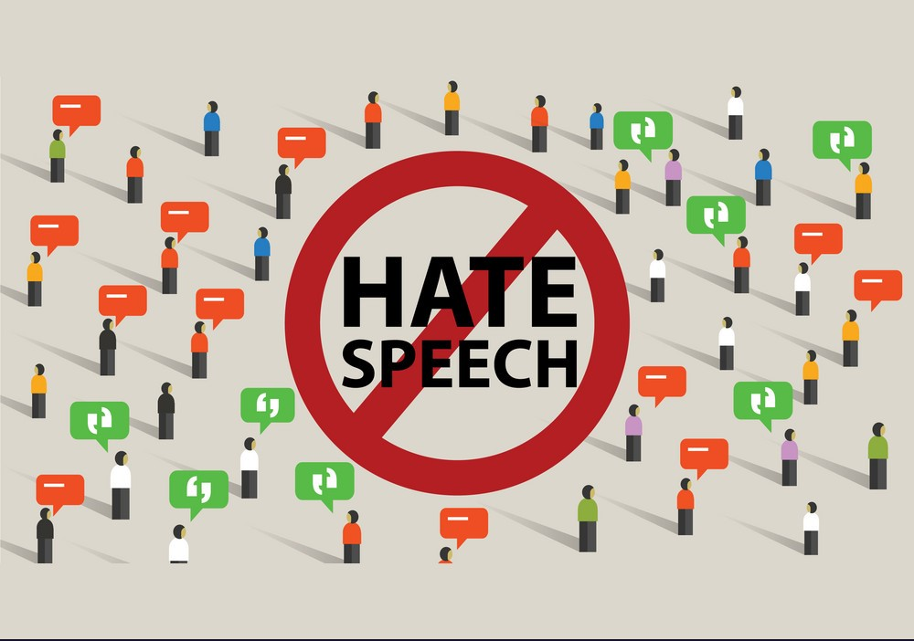
HATE SPEECH DETECTION
AN NLP PROJECT

Slide 2

Participants:
Alpha Guya
Flavine Atieno
Sharon Njogu

Slide 3
Project Overview

Slide 4
About the data
A dataset utilizing Twitter data was employed for researching hate-speech identification.
The text was categorized as hate-speech, offensive language, or neither.
Given the study's nature, it is imperative to acknowledge that this dataset contains text that may be deemed racist, sexist, homophobic, or generally offensive.
Data Source:

Slide 5

About the data…
Overview of the dataset columns
Count, hate_speech, offensive_language, neither
Class distribution and imbalance
Transformation of classes into binary
Significant class imbalance noted
We have 2 classes, hate speech (0) and non-hate speech (1)

Slide 6
Problem Statement:
Detecting hate speech in natural language processing (NLP) is challenging. Hate speech involves offensive language and discrimination based on attributes like race or gender. Current NLP algorithms struggle to accurately discern hate speech, risking online platform integrity and user safety.
Establishing effective hate speech detection is vital for online security and fostering an inclusive environment. Goals include a discrimination-free online discourse, mitigating harm, and promoting constructive dialogue.
Identifying and detecting hate speech is crucial for a safer online environment. Collaboration among platforms, users, governments, NGOs, law enforcement, education, and tech developers is key.

Slide 7
Objectives
1. Develop an Efficient Hate Speech Detection Model:
- Design and implement an NLP algorithm capable of accurately identifying and classifying hate speech in diverse online content.
2. Enhance Algorithm Robustness:
- Improve the algorithm's ability to handle nuanced language, variations, and evolving forms of hate speech, ensuring adaptability to changing online discourse.
3. Reduce False Positives and Negatives:
- Minimize instances of misclassification by fine-tuning the model to decrease false positives (incorrectly identifying non-hate speech as hate speech) and false negatives (failing to detect actual hate speech).
4. Evaluate Real-world Impact:
- Conduct thorough evaluations of the algorithm's performance in real-world scenarios, considering various online platforms and communication contexts.

Slide 8
EDA & Data Preparation

Slide 9
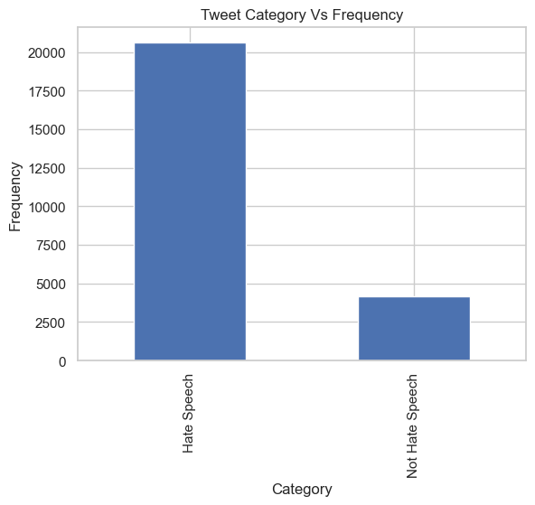
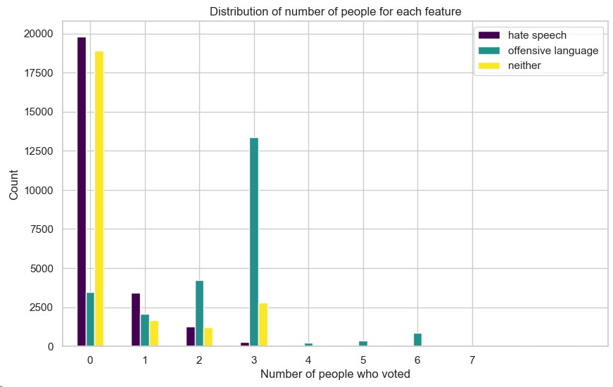
Exploratory Data Analysis (Visualization)

Slide 10
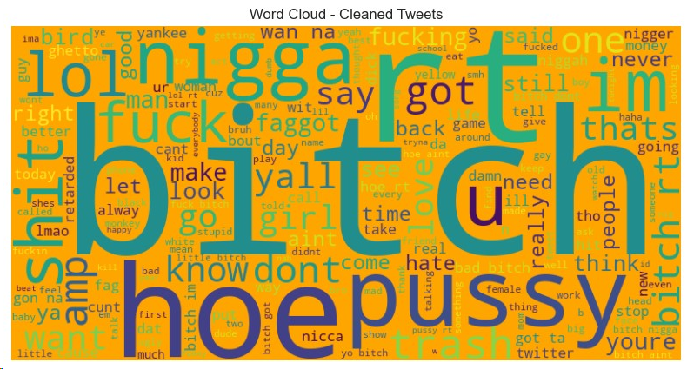
Word cloud Shows mostly used words in the hate speech dataset

Slide 11
Model Training Models used: Logistic Regression, Decision Tree, Gradient Boosting

Slide 12
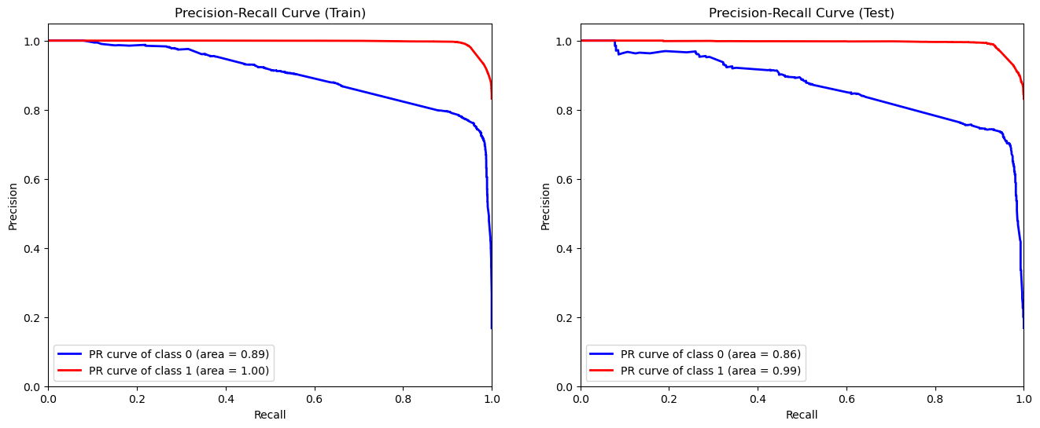
Model Evaluation
The best performing model is the Tuned Gradient Boosting Machine, that has shown good results in terms of accurately predicting words into hate speech and non hate speech category

Slide 13
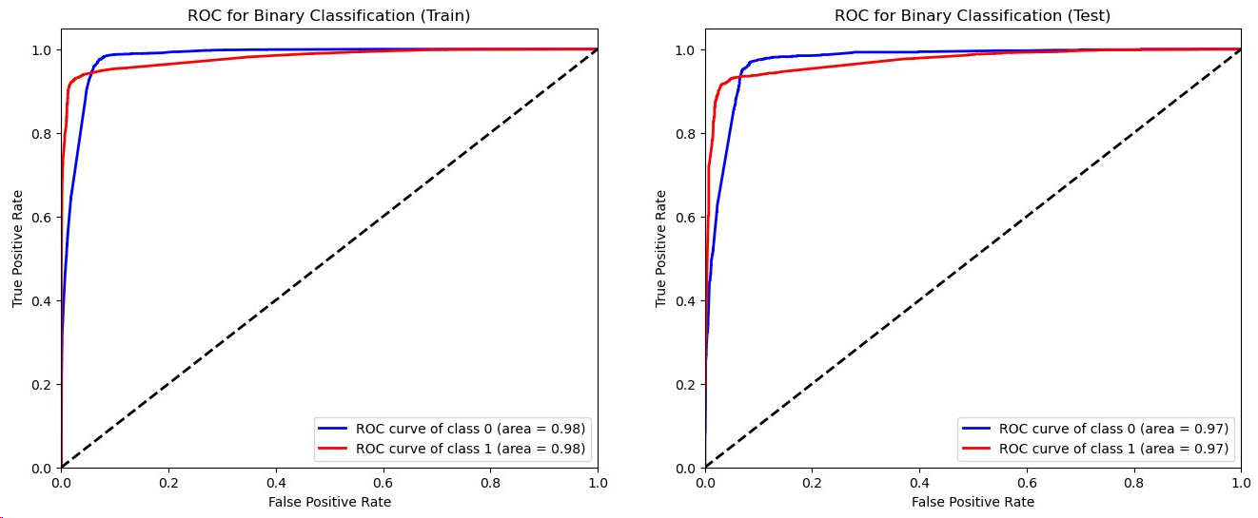
Gradient Boosting Model: Showing the results of binary classification on both the train and test data

Slide 14
Challenges and Solutions

Slide 15
Challenges and Solutions
Challenges faced during the project
Imbalanced dataset: Significant class imbalance in hate speech identification
Ambiguity in text: Difficulty in distinguishing between offensive language and hate speech
Computational resources: Resource-intensive models impacting scalability
Implemented / suggested solutions
Class Weighting: Applied class weights to address imbalanced data, emphasizing hate speech instances
Fine-tuning NLP models: Tweaked hyperparameters and utilized pre-trained word embeddings to improve text understanding
Parallel Processing: Implemented parallel processing to optimize resource usage

Slide 16
Conclusion

Slide 17
Recap: Key Findings:
Model Performance:
Achievements: The chosen model demonstrated remarkable accuracy in identifying hate speech instances.
Effectiveness: Successfully mitigated the challenges posed by ambiguous and evolving language.
Impact on User Safety:
Positive Influence: The implementation of advanced hate speech identification significantly enhances user safety.
Preventive Measures: Proactive content moderation helps create a digital space less prone to harmful behavior.
Significance of Hate Speech Identification in Creating a Safer Online Environment:
Fostering Inclusivity:
Promoting Diversity: Hate speech identification fosters an online environment that welcomes users from diverse backgrounds.
Ensuring Respect: Contributes to the creation of a space where all users feel respected and valued.
Building Trust:
User Confidence: A robust hate speech identification system builds user trust in online platforms.
Platform Responsibility: Platforms play a crucial role in maintaining a healthy online ecosystem through effective content moderation.

Slide 18
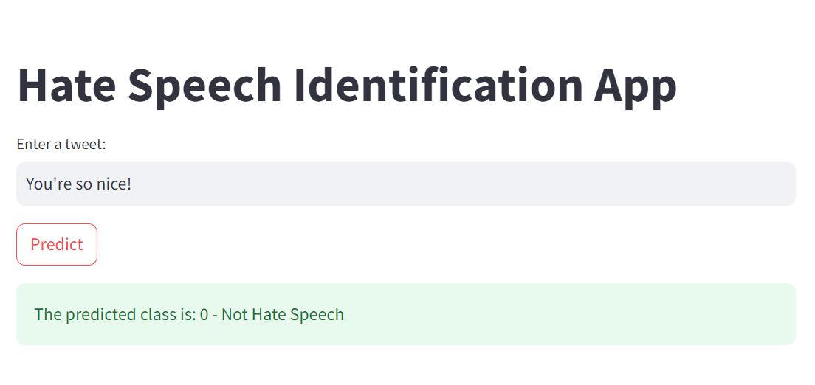
Deployment
Using Streamlite

Slide 19
Recommendation

Slide 20
Recommendations for Improving Hate Speech Identification:
Continuous Model Training: Regularly update models to adapt to evolving language and emerging hate speech trends.
User Reporting Mechanism: Implement a robust reporting system for users to flag potential hate speech instances.
Human-in-the-Loop (HITL): Combine AI models with human moderators for nuanced decisions.

Slide 21


